Slide 1
Python Integration With SQL

Slide 2
Learning Objective:
By the end of this lesson, learners will be able to develop a straightforward Python application to interact with MySQL databases.
Python SQL Module

Slide 3
Table of Contents
Introduction to Python Database Driver.
Steps to use Python Database Driver.
Step 1: Import the API Module.
Step 2: Open the Database Connection.
Step 3: Prepare and Issue SQL Statements to the Database.
Verify Database Connection is established.
Utilizing Exception Handling.
Parameterized Query.
Insert Data into MySQL Table From Python.

Slide 4
Introduction
All software applications interact with data, most commonly, through a database management system (DBMS). Some programming languages come with modules that you can use to interact with a DBMS, while others require the use of third-party packages.
In this lesson, we will explore the Python SQL module to interact with Python with the SQL database.

Slide 5
Introduction to Python Database Driver
The mysql-connector-python is a Python driver (or connector) for MySQL databases. It allows Python developers to connect to, and interact with MySQL database systems from within their Python applications. This library provides an interface to execute SQL queries, manage database connections, and retrieve and manipulate data in MySQL databases
You will need to install a Python SQL driver for MySQL to interact with a MySQL database from within a Python application. One such driver is mysql-connector-python. You can download this Python SQL module with pip:
From the terminal/command prompt, run the following:
pip install mysql-connector-python
If you are in a Jupyter notebook, you can use an exclamation mark to install via a system call:
!pip install mysql-connector-python

Slide 6
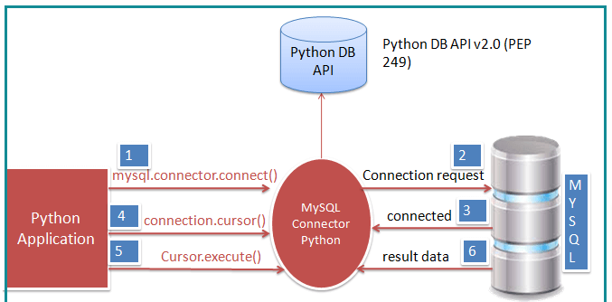
Steps to use Python Database Driver
Import the API Module.
Open the database connection.
Prepare and issue SQL statements to the database:
Obtain the result from the database.
Close the connection.
Img src: pypi.org

Slide 7
Step 1: Import the API Module
mysql-connector-python is a MySQL Connector for Python. You can use this module’s methods to communicate with the MySQL database.
Use the following code to import the module:
import mysql.connector as dbconnection

Slide 8
Step 2: Open the Database Connection
Use the connect() method of the MySQL Connector class with the required arguments to connect MySQL. It would return a MySQLConnection object if the connection is established successfully.
myconnection = dbconnection.connect(host='localhost', database='classicmodels', user='root', password='password')
Myconnection = print(myconnection)
Note: Here, we used the classicmodels database. You can use/connect with any database. And do not forget to change the username and password.
Notes:
We call the connect method from the connector and pass in the arguments to open the database connection.
Some of the arguments have the default values so we don't have to pass in those values unless we want to use the different values (host='127.0.0.1', port=3306, etc.)

Slide 9
Step 3: Prepare and Issue SQL Statements to the Database
cursor() method: Use the cursor() method of a MySQLConnection object to create a cursor object to perform various SQL operations.
execute() method: The execute() method runs the SQL query and returns the result.
Extract result using fetchall() Use cursor.fetchall(), fetchone() or fetchmany() to read the query result.
Close cursor and connection objects Use cursor.close() and connection.close() method to close open connections after your work completes.

Slide 10
Step 3: Prepare and Issue SQL Statements to the Database - Continued
import mysql.connector as dbconnect
myconnection = dbconnect.connect(host='localhost', database='classicmodels', user='root', password='mypassword')
# Get a cursor
cursor = myconnection.cursor()
SQLQuery ="SELECT ordernumber, SUM(quantityOrdered) AS itemsCount, SUM(priceeach*quantityOrdered) AS total FROM orderdetails GROUP BY ordernumber HAVING total > 1000 AND itemsCount > 600";
# Execute a query
cursor.execute(SQLQuery)
# get all records
records = cursor.fetchall()
print("Total number of rows in table: ", cursor.rowcount)
print("\nPrinting each row")
for row in records:
print("order number = ", row[0], )
print("item counts = ", row[1])
print("total = ", row[2], "\n" )
# Close connection
cursor.close()
myconnection.close()
Note: Here, we used the classicmodels database. You can use/connect with any database.

Slide 11
Verify Database Connection is Established
Python can raise an exception. For instance, an exception can occur if MySQL is not available, or if the database does not exist or is an invalid username or password.
We can check that the connection to the MySQL database has been established successfully by using the is_connected() method.
conn =dbconnect.connect(host='localhost', database='classicmodels', user='root', password='password', port='3306')
if conn.is_connected():
print('Successfully Connected to MySQL database')
Output:
“Successfully Connected to MySQL database.”

Slide 12
Utilizing Exception Handling
The try except block handles the exception and displays the error.
import mysql.connector as dbconnect
from mysql.connector import Error
try:
myconnection = dbconnect.connect(host='localhost',database='classicmodels',user='root',password='password')
if myconnection.is_connected():
print('Successfully Connected to MySQL database')
cursor = myconnection.cursor()
SQLQuery ="SELECT ordernumber, SUM(quantityOrdered) AS itemsCount, SUM(priceeach*quantityOrdered) AS total FROM orderdetails GROUP BY ordernumber HAVING total > 1000 AND itemsCount > 600";
cursor.execute(SQLQuery)
# get all records
records = cursor.fetchall()
print("Total number of rows in table: ", cursor.rowcount)
print("\nPrinting each row")
for row in records:
print("order number = ", row[0], )
print("item counts = ", row[1])
print("total = ", row[2], "\n" )
except Error as e:
print("Error while connecting to Database", e)
finally:
if myconnection.is_connected():
cursor.close()
myconnection.close()
print("Database connection is closed")

Slide 13
Hands-On Activity
Complete the Guided Lab 342.3.1 - Connecting to MySQL database using connect() function. You can find this lab on Canvas under the Assignment section.
If you have any questions while completing this lab, please contact your instructor for assistance.

Slide 14
Example: Create a TABLE
In this example, we are going to create a table by using Python and “mysql” module.
import mysql.connector as mydbconnection
from mysql.connector import Error
conn = mydbconnection.connect(database='usersdb', user='root',password='password', port ='3306')
cursor=conn.cursor()
myquery = "CREATE TABLE tasks (task_id INT AUTO_INCREMENT,title VARCHAR(255) NOT NULL,\
start_date DATE,\
due_date DATE,\
priority TINYINT NOT NULL DEFAULT 3,\
description TEXT,\
PRIMARY KEY (task_id))"
cursor.execute(myquery)

Slide 15
Parameterized Query
A parameterized query is a query in which placeholders (%s) are used for parameters and the parameter values are supplied at execution time.
We use the Parameterized query to use Python variable in SQL query.
For example:
We often need to pass variables to the SQL select query in the Where Clause to check some conditions.
In the user signup form, the user enters his/her details. You can take those values in Python variables and insert them into a table.

Slide 16
Example: Parameterized Query
Create a file named SelectOffice.py and add the code below:
import mysql.connector as mydbconnection
from mysql.connector import Error
def get_laptop_detail(id):
conn = mydbconnection.connect(database='classicmodels', user='root', password='password')
cursor = conn.cursor()
sql_select_query = """select * from offices where officeCode = %s"""
# set variable in query
cursor.execute(sql_select_query, (id,))
# fetch result
record = cursor.fetchall()
for row in record:
print("officeCode = ", row[0], )
print("city = ", row[1])
print("Phone = ", row[2])
print("addressline1 = ", row[3], "\n")
cursor.close()
conn.close()
print("MySQL connection is closed")
get_laptop_detail(1)
get_laptop_detail(2)

Slide 17
Example: Parameterized Query
If you are not using a Jupyter notebook, open the command line interface, and use the following command:
python SelectOffice.py
Result:
officeCode = 1
city = San Francisco
Phone = +1 650 219 4782
addressline1 = 100 Market Street
MySQL connection is closed
officeCode = 2
city = Boston
Phone = +1 215 837 0825
addressline1 = 1550 Court Place
MySQL connection is closed

Slide 18
Insert Data into MySQL Table From Python
For single row: We can use the execute() method of cursor object to insert a single record.
For multiple row: We can use the executemany() method of cursor object to insert multiple records into a table.
Syntax of the executemany() method.
cursor.executemany(operation, seq_of_params)
Commit your changes
You have to explicitly call the commit() method in order to make the changes to the database.
Get the number of rows affected After a successful insert operation, use a cursor.rowcount() method to get the number of rows affected. The count depends on how many rows you are inserting.

Slide 19
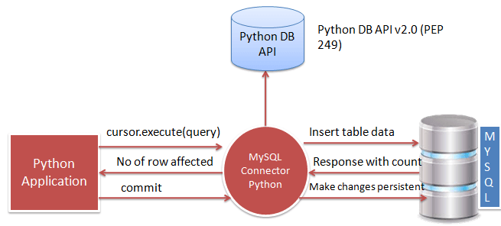
Insert Data into MySQL Table From Python (continued)
High level workflow for Insert Data into MySQL using Python
Img src: pypi.org

Slide 20
Guided Lab - Hands-On Activity
Complete the following labs:
Guided LAB 342.3.2 - Inserting Data into MySQL from Python.
Guided LAB 342.3.3 - API Data Extraction and MySQL Database Integration.
You can find these labs on Canvas under the Assignment section.
If you have any questions while completing this lab, please contact your instructor for assistance.

Slide 21
Practice Assignment
Complete the assignment PA 342.3.1- Practice Assignment - Python Database API. You can find this assignment on Canvas under the Assignment section.
If you have any questions while completing this assignment, please contact your instructor for assistance.

Slide 22
Knowledge Check
What does the Python library use to connect to and interact with MySQL databases?
What are the five steps involved in using a Python database driver?
How do you verify that a database connection has been successfully established?
What is a parameterized query and why is it used?

Slide 23
Summary
MySQL Connector/Python enables Python programs to access MySQL databases, using an API that is compliant with the Python Database API Specification v2.0 (PEP 249). It is written in pure Python and does not have any dependencies except for the Python Standard Library. Methods include:
The cursor() method of a MySQLConnection object is used to create a cursor object to perform various SQL operations.
The execute() methods run the SQL query and return the result.
The cursor.close() and connection.close() methods are used to close open connections after work completes.
The connect() method can throw a Database error exception if one of the required parameters is wrong.

